Slide 1
(8,4,4) Viterbi Decoder
Group 2: Harsh Aurora, Adam Cavatassi, Xiaoqing Ma, Dylan Watts

Slide 2
Overview
Background
Encoding, transmission and decoding basics.
Overview of the Viterbi (8,4,4) trellis.
Schematic and Layout
Design overview of key modules.
Implementation in schematic and layouts.
Testing
Propagation Delay
Power
Summary of Major Work
Future Work
References

Slide 3
Background
Harsh Aurora

Slide 4
Simplified Transmission Model
Transmitter
Channel
Receiver
Information Source
Encoder
Modulator
Demodulator
Decoder
Information Sink
Output message bits
Message bits + error control
Transmission
pulses
Gaussian Noise Corruption
Pulse sampling
Message recovery
Input message bits
[1.3, 0.1, 0.5, 1.8, -0.2, 0.5, 0.9, 0.1]
[1011]
[10110010]
[10X10X10]
[1011]

Slide 5
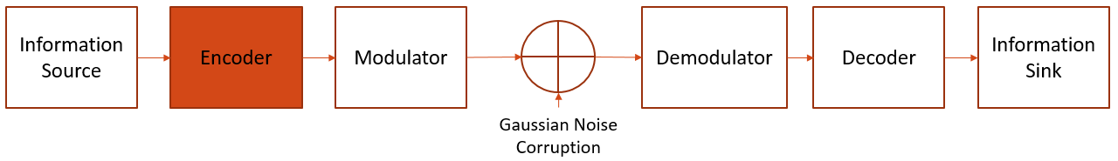
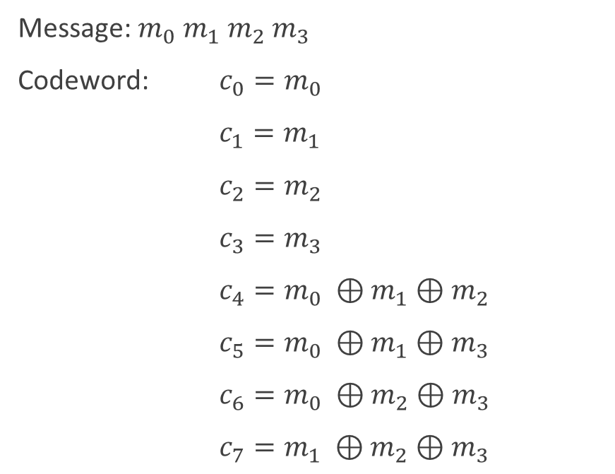
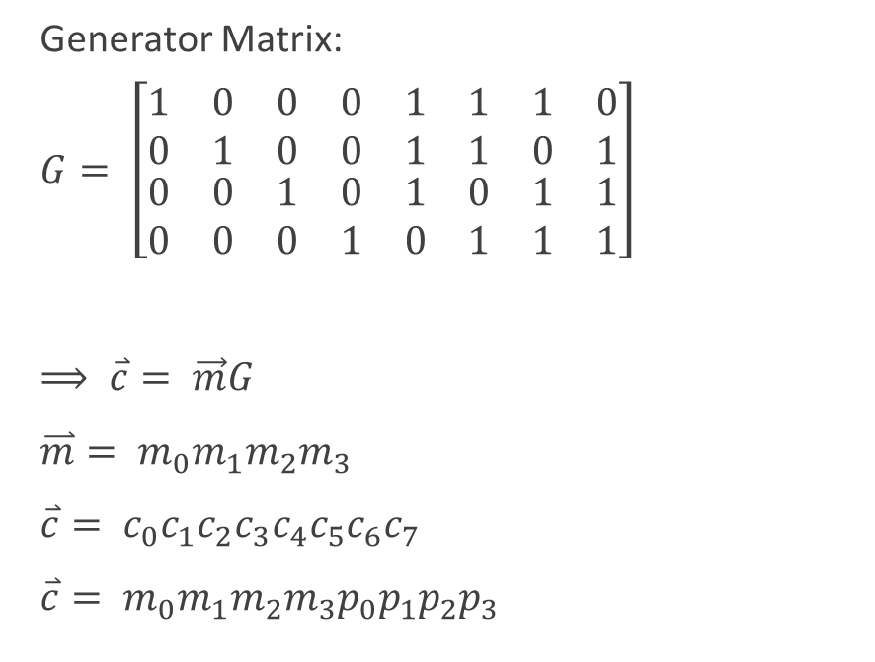
Hamming (8,4,4) Encoder
Message: $m_{0}{ m}_{1}{ m}_{2}{ m}_{3}$
Codeword: $c_{0}=m_{0}$
$c_{1}=m_{1}$
$c_{2}=m_{2}$
$c_{3}=m_{3}$
$c_{4}=m_{0} ⊕m_{1}⊕m_{2}$
$c_{5}=m_{0} ⊕m_{1}⊕m_{3}$
$c_{6}=m_{0} ⊕m_{2}⊕m_{3}$
$c_{7}=m_{1} ⊕m_{2}⊕m_{3}$
Generator Matrix:
$G= \left[\begin{matrix}\begin{matrix}\begin{matrix}\begin{matrix}\begin{matrix}1 & 0\end{matrix} & \begin{matrix}0 & 0\end{matrix}\end{matrix} & \begin{matrix}\begin{matrix}1 & 1\end{matrix} & \begin{matrix}1 & 0\end{matrix}\end{matrix}\end{matrix} \\ \begin{matrix}\begin{matrix}\begin{matrix}0 & 1\end{matrix} & \begin{matrix}0 & 0\end{matrix}\end{matrix} & \begin{matrix}\begin{matrix}1 & 1\end{matrix} & \begin{matrix}0 & 1\end{matrix}\end{matrix}\end{matrix}\end{matrix} \\ \begin{matrix}\begin{matrix}\begin{matrix}\begin{matrix}0 & 0\end{matrix} & \begin{matrix}1 & 0\end{matrix}\end{matrix} & \begin{matrix}\begin{matrix}1 & 0\end{matrix} & \begin{matrix}1 & 1\end{matrix}\end{matrix}\end{matrix} \\ \begin{matrix}\begin{matrix}\begin{matrix}0 & 0\end{matrix} & \begin{matrix}0 & 1\end{matrix}\end{matrix} & \begin{matrix}\begin{matrix}0 & 1\end{matrix} & \begin{matrix}1 & 1\end{matrix}\end{matrix}\end{matrix}\end{matrix}\end{matrix}\right]$
$⟹ \overset{⃑}{c}= \vec{m}G$
$\overset{⃑}{m}= m_{0}m_{1}m_{2}m_{3}$
$\overset{⃑}{c}= c_{0}c_{1}c_{2}c_{3}c_{4}c_{5}c_{6}c_{7}$
$\overset{⃑}{c}= m_{0}m_{1}m_{2}m_{3}p_{0}p_{1}p_{2}p_{3}$

Slide 6
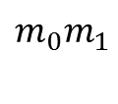

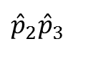






Hamming (8,4,4) Encoder: Optimized Trellis
$$m_{0}m_{1}/m_{0}m_{1}$$
$$m_{0}m_{1}$$
$$m_{2}/m_{2}p_{0}$$
$${\hat{p}}_{2}{\hat{p}}_{3}$$
$$m_{3}/m_{3}p_{1}$$
$$p_{2}p_{3}$$
-$/p_{2}p_{3}$
00
0/00
00
0/00
00
00/00
1/11
1/11
1/11
1/11
-/00
11
11
11
11/11
0/00
0/00
-/11
Start
End
10/10
10
0/01
10
0/01
10
-/10
01/01
-/01
1/10
1/10
1/10
1/10
01
01
01
0/01
0/01
Example: $\overset{⃑}{m}=0101$
$$⟹ \overset{⃑}{c}=01011010$$

Slide 7
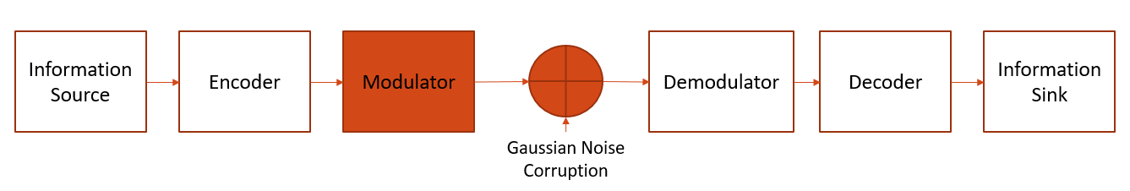
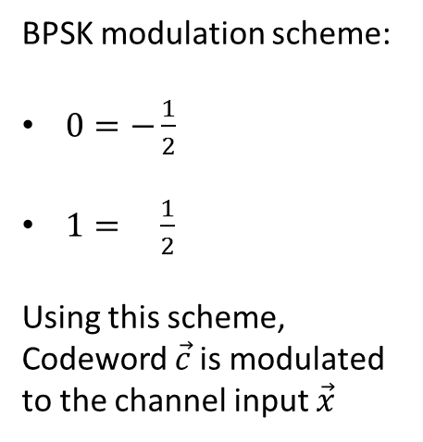
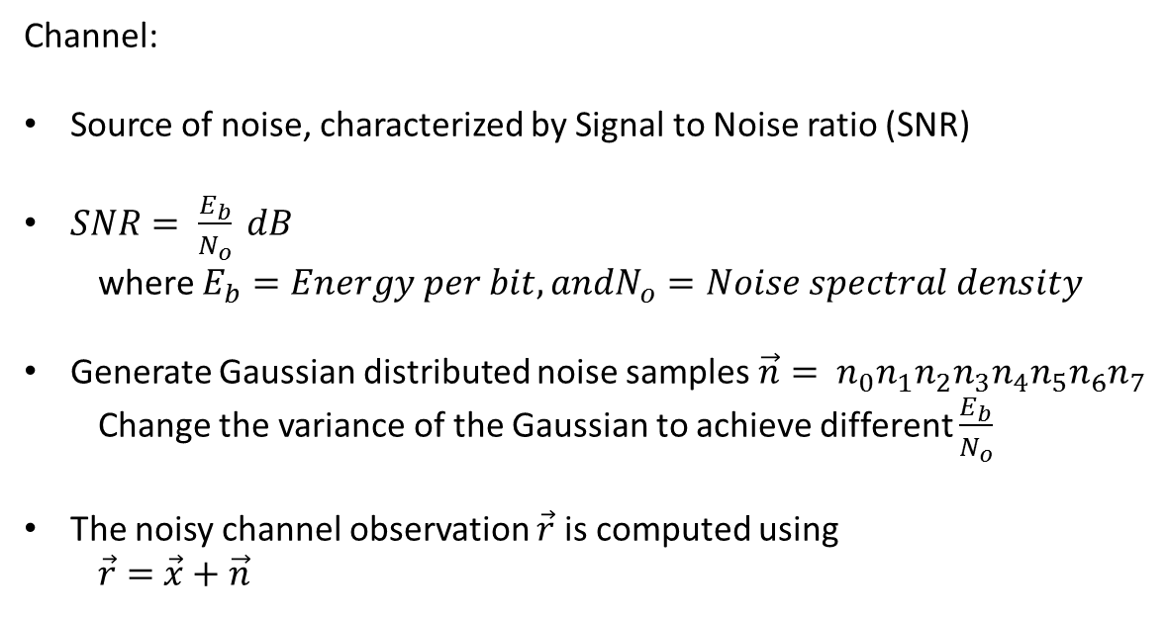
Modulator and Channel
BPSK modulation scheme:
$0=−\frac{1}{2}$
$1= \frac{1}{2}$
Using this scheme, Codeword $\vec{c}$ is modulated to the channel input $\vec{x}$
Channel:
Source of noise, characterized by Signal to Noise ratio (SNR)
$SNR= \frac{E_{b}}{N_{o}} dB$
where $E_{b}=Energy per bit, andN_{o}=Noise spectral density$
Generate Gaussian distributed noise samples$\vec{n}= n_{0}n_{1}n_{2}n_{3}n_{4}n_{5}n_{6}n_{7}$
Change the variance of the Gaussian to achieve different $\frac{E_{b}}{N_{o}}$
The noisy channel observation $\vec{r}$ is computed using
$\vec{r}=$ $\vec{x}+\vec{n}$

Slide 8
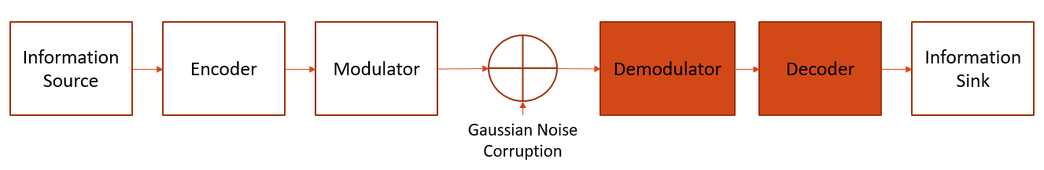
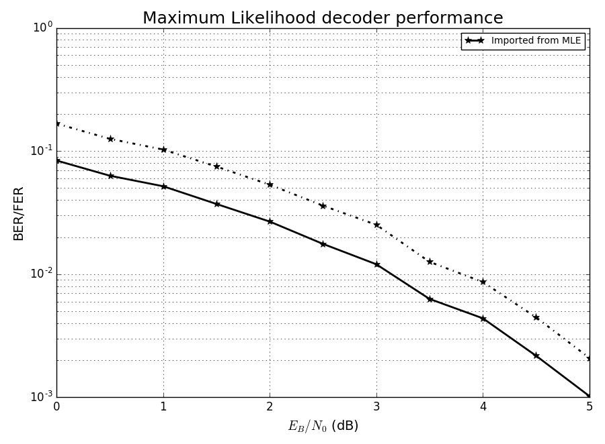
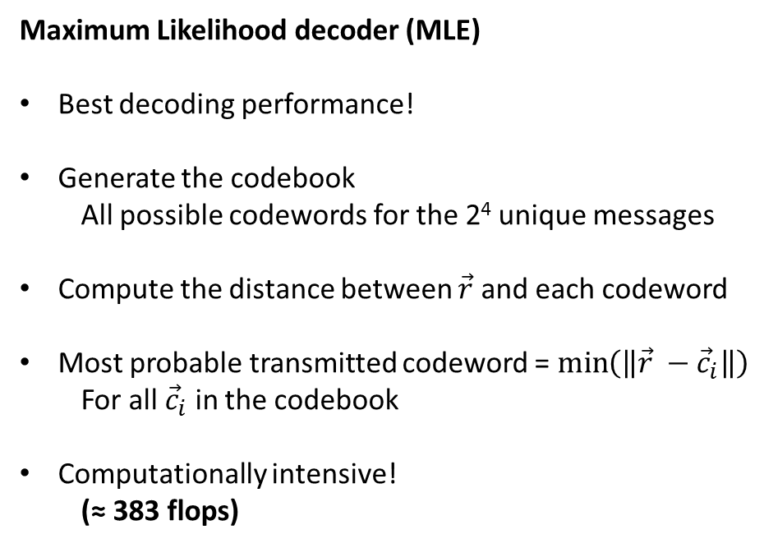
Hamming (8,4,4)
Decoder
Aim: Retrieve the sent message $\vec{m}$, given the noisy channel observation $\vec{r}= r_{0}r_{1}r_{2}r_{3}r_{4}r_{5}r_{6}r_{7}$
Maximum Likelihood decoder (MLE)
Best decoding performance!
Generate the codebook
All possible codewords for the 2⁴ unique messages
Compute the distance between $\vec{r}$ and each codeword
Most probable transmitted codeword = $\min\left(\left\|\vec{r} −{\vec{c}}_{i}\right\|\right)$
For all ${\vec{c}}_{i}$ in the codebook
Computationally intensive!
(≈ 383 flops)
Figure 1: Maximum likelihood decoder performance.

Slide 9
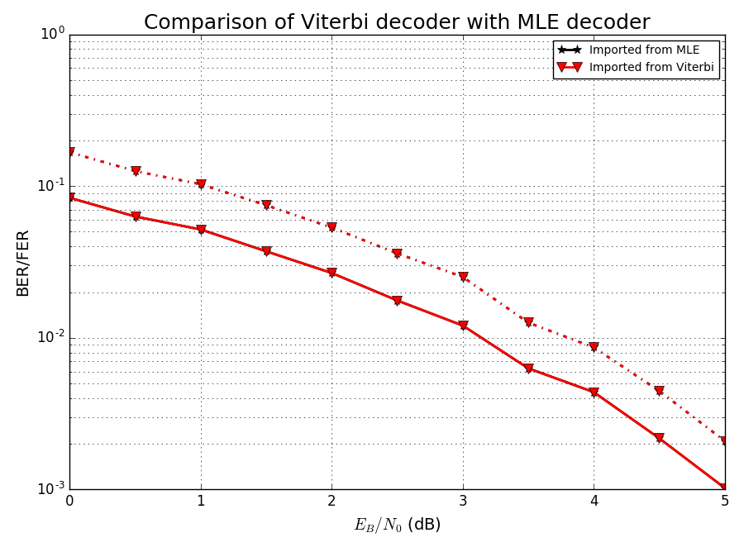
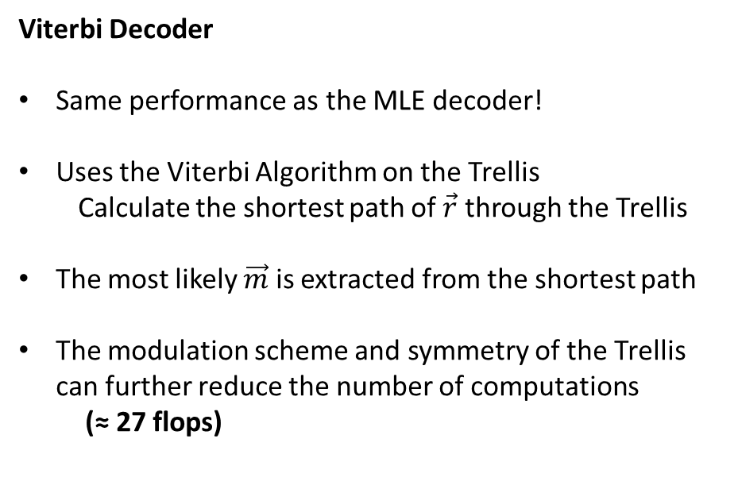
Hamming (8,4,4)
Decoder
Viterbi Decoder
Same performance as the MLE decoder!
Uses the Viterbi Algorithm on the Trellis
Calculate the shortest path of $\vec{r}$ through the Trellis
The most likely $\vec{m}$ is extracted from the shortest path
The modulation scheme and symmetry of the Trellis can further reduce the number of computations
(≈ 27 flops)
Figure 2: Comparison of Viterbi decoder with MLE decoder.

Slide 10





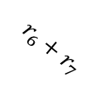


























Hamming (8,4,4)
Decoder
$$\frac{−1}{ 2} \frac{−1}{ 2}$$
$$r_{2}+r_{4}$$
$$\frac{−1}{ 2} \frac{−1}{ 2}$$
$$r_{3}+r_{5}$$
$$\frac{−1}{ 2} \frac{−1}{ 2}$$
$$r_{0}+r_{1}$$
$$0$$
$$0$$
$$0$$
$$0$$
$$r_{6}+r_{7}$$
$$\frac{1}{2} \frac{1}{2}$$
$$\frac{1}{2} \frac{1}{2}$$
$$\frac{1}{2} \frac{1}{2}$$
$$0$$
$$r_{2}+r_{4}$$
$$r_{3}+r_{5}$$
$$0$$
Start
End
$$r_{1}$$
$$\frac{1}{2} \frac{−1}{ 2}$$
$$r_{2}$$
$$\frac{1}{2} \frac{−1}{ 2}$$
$$r_{3}$$
$$\frac{1}{2} \frac{−1}{ 2}$$
$$r_{6}$$
$$r_{0}$$
$$r_{7}$$
$$r_{4}$$
$$r_{4}$$
$$r_{5}$$
$$r_{5}$$
$$\frac{−1}{ 2} \frac{1}{2}$$
$$\frac{−1}{ 2} \frac{1}{2}$$
$$\frac{−1}{ 2} \frac{1}{2}$$
$$r_{2}$$
$$r_{3}$$
Figure 3: Example of Hamming (8,4,4) trellis decoder.

Slide 11
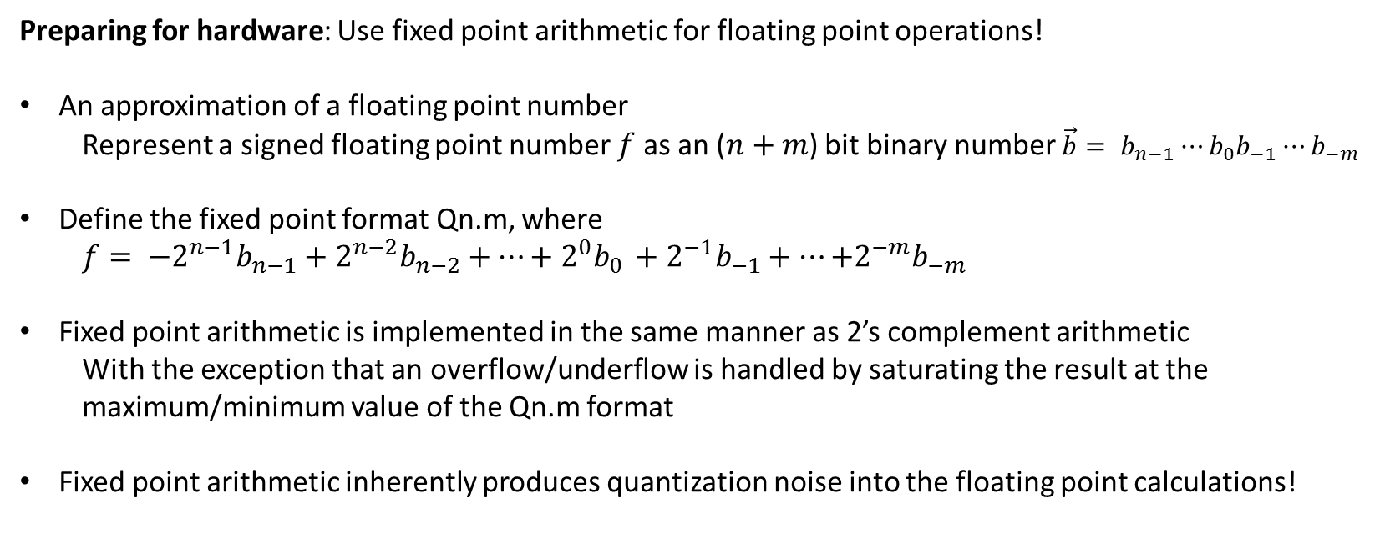
Hamming (8,4,4)
Decoder
Preparing for hardware: Use fixed point arithmetic for floating point operations!
An approximation of a floating point number
Represent a signed floating point number $f$ as an ($n+m$) bit binary number $\vec{b}= b_{n−1}⋯b_{0}b_{−1}⋯b_{−m}$
Define the fixed point format Qn.m, where
$f= {−2}^{n−1}b_{n−1}+2^{n−2}b_{n−2}+⋯+2^{0}b_{0 }+{2^{−1}b}_{−1}+⋯{+2^{−m}b}_{−m}$
Fixed point arithmetic is implemented in the same manner as 2’s complement arithmetic
With the exception that an overflow/underflow is handled by saturating the result at the maximum/minimum value of the Qn.m format
Fixed point arithmetic inherently produces quantization noise into the floating point calculations!

Slide 12
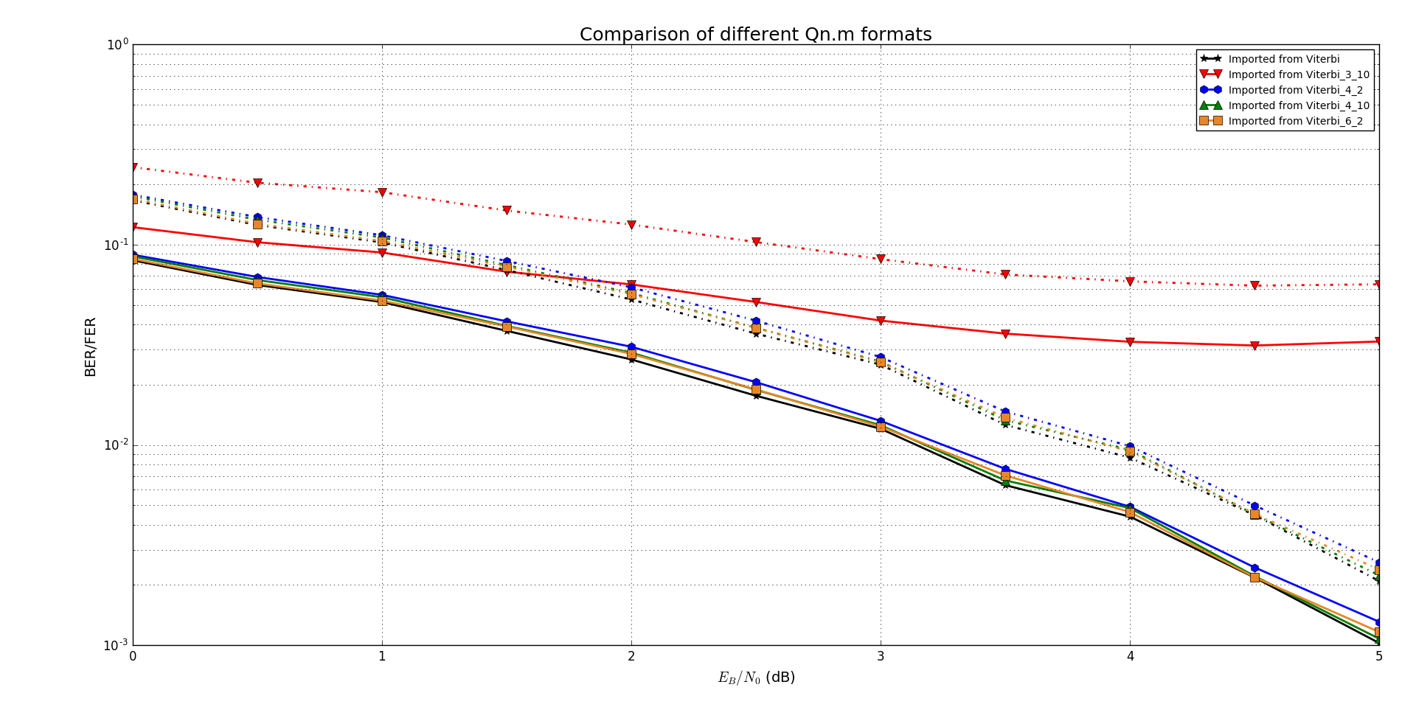
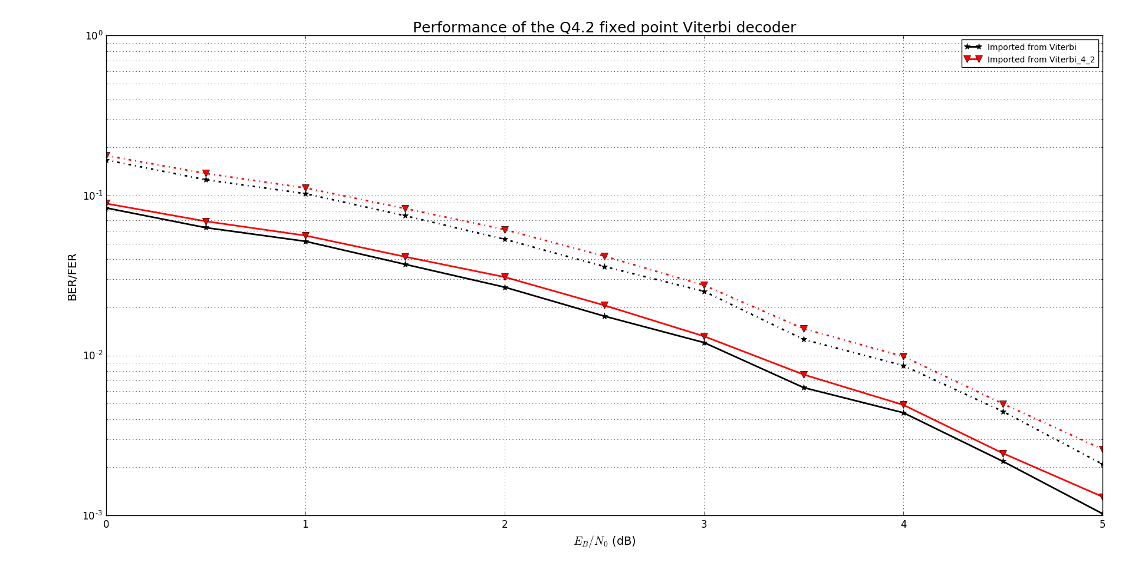
Hamming (8,4,4)
Decoder
Obtain the performance of the Viterbi decoder for different Qn.m formats
Q3.10
Not enough integer range
Q4.2
Slight quantization noise
Q4.10
Greater fractional precision reduces noise, but at high cost (8 bits in this case)
Q6.2
Marginal improvements for greater integer range
Figure 4: Performance of various fixed point lengths

Slide 13
Schematic and Layout
Adam Cavatassi, Xiaoqing Ma

Slide 14
Design Summary
AMI 0.5μm process
MOSIS scalable CMOS submicron design rules
λ = 0.3μm

Slide 15
Design Goals
Schematics and layout of 2 viterbi decoder
Optimized for speed and power respectively
Schematics and layouts of related modules
DRC ERC NCC

Slide 16
Required Modules
6-bit Adder
Optimization for Speed: Kogge-Stone Adder
Optimization for Power: Carry-Ripple Adder
6-bit Signed Number Comparator
6-bit Multiplexer

Slide 17
Adder
6-bit signed binary addition
If result < -32 (10000), output result as -32
If result > 31 (01111), output result as 31
Overflow
Check whether the result is out of range [-32, 31]

Slide 18
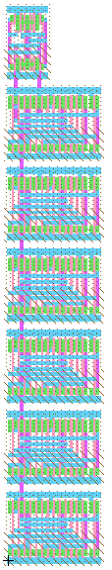
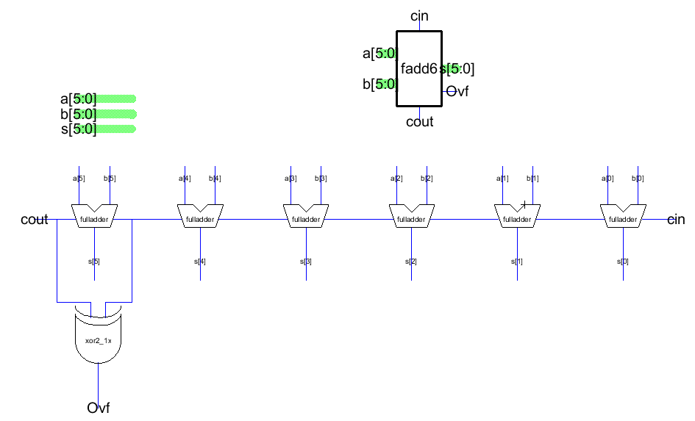
Carry-Ripple Adder
Figure 5: Schematic and layout of 6-bit carry-ripple adder

Slide 19
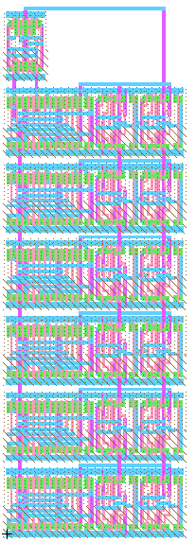
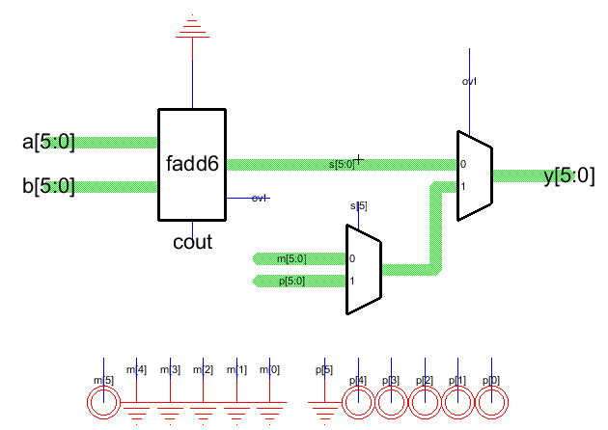
Carry-Ripple Adder
Figure 6: Schematic and layout of 6-bit carry-ripple adder

Slide 20
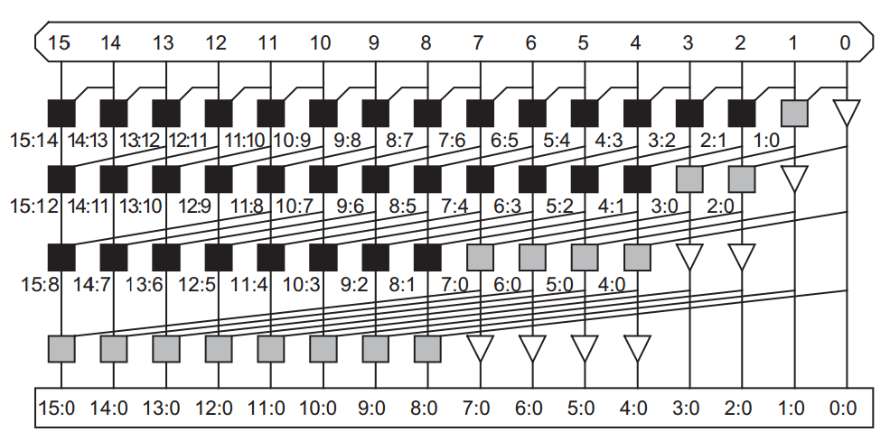
Kogge-Stone (Tree Adder) – General Diagram
Figure 7 Reproduced from [1]: 16-bit kogge-stone adder PG networks

Slide 21
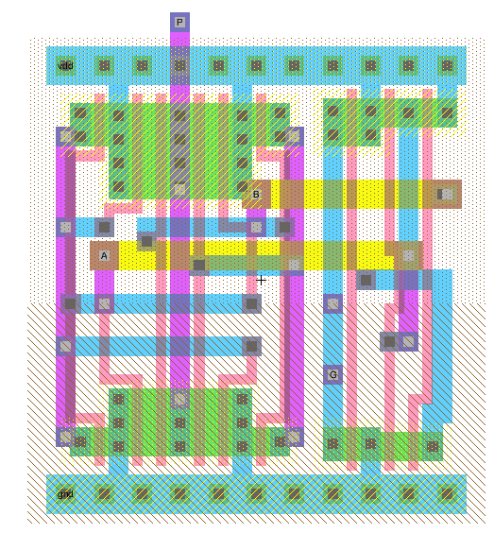
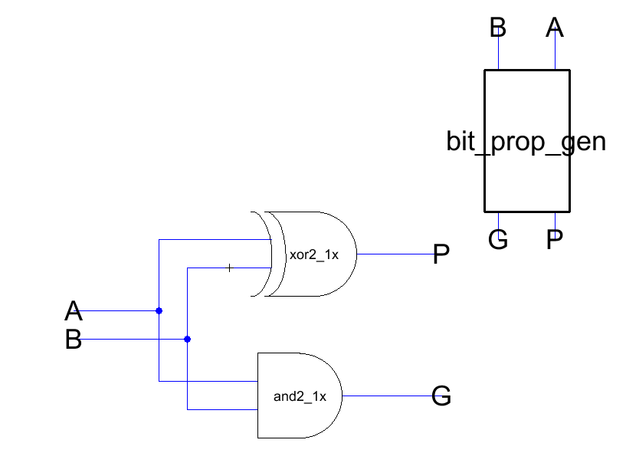
Kogge-Stone (Tree Adder) – Bitwise PG Logic
Figure 8: Schematic and layout of bitwise PG logic

Slide 22
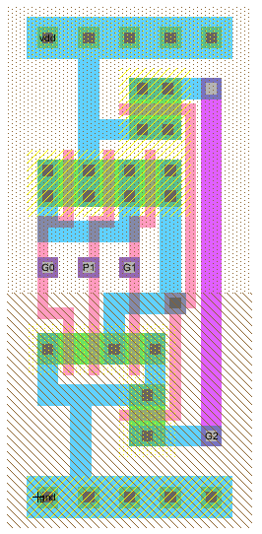
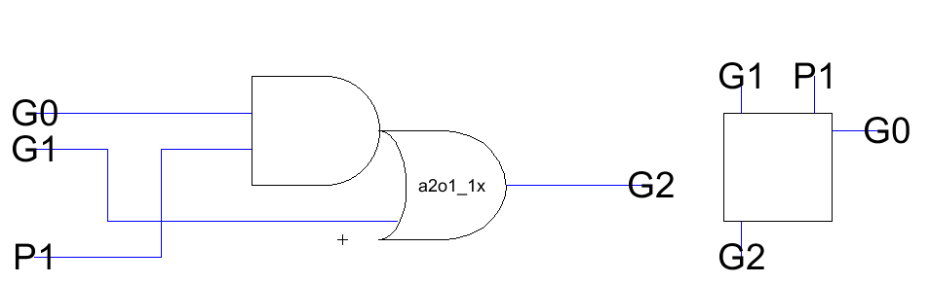
Kogge-Stone (Tree Adder) – Group PG Logic
Figure 9: Schematic and layout of group PG logic (white cell)

Slide 23
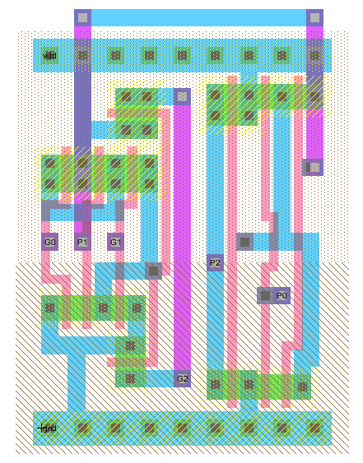
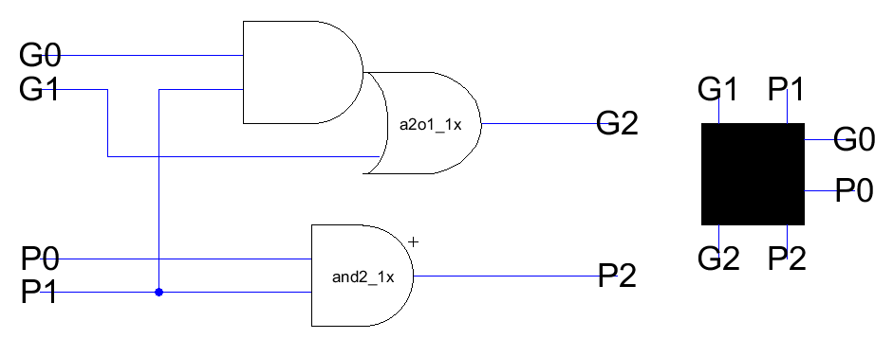
Kogge-Stone (Tree Adder) – Group PG Logic
Figure 10: Schematic and layout of group PG logic (black cell)

Slide 24
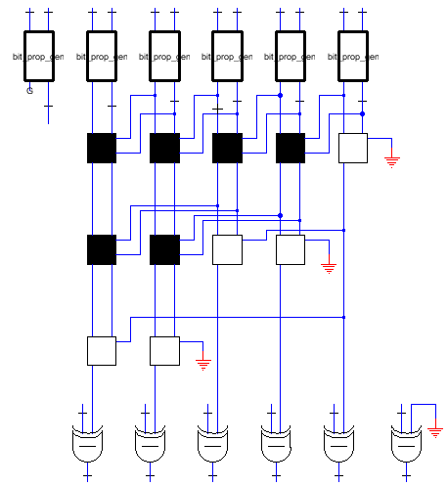
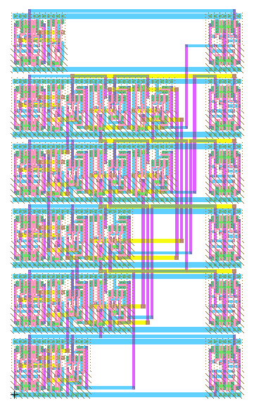
Kogge-Stone (Tree Adder) – Overall Design
Bitwise PG Logic
Rotate 90 Degrees Counterclockwise
Group PG Logic
Sum Logic
Figure 11: Schematic and layout of 6-bit kogge-stone adder

Slide 25
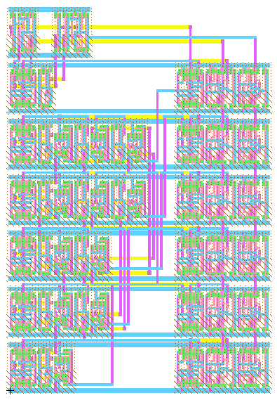
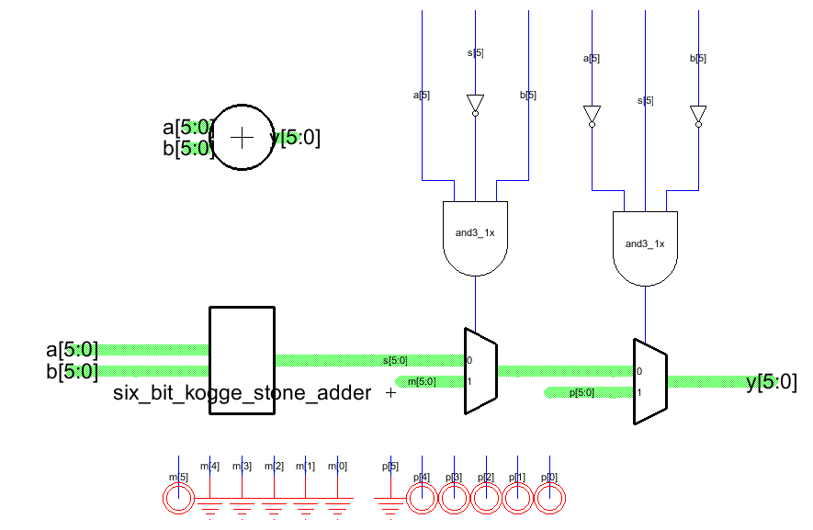
Kogge-Stone (Tree Adder) – Overall Design
Figure 12: Schematic and layout of 6-bit kogge-stone adder

Slide 26
Comparator - Components
6-bit Carry-Ripple Adder
6-bit Inverter
1-bit XOR

Slide 27
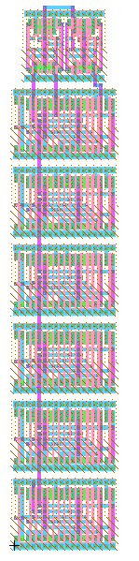
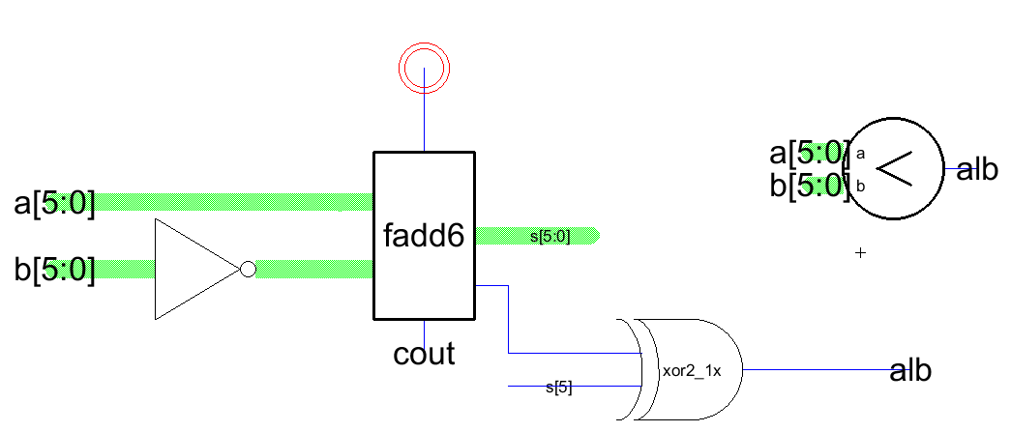
Comparator – Schematic and Layout
Figure 13: Schematic and layout of 6-bit comparator

Slide 28
Miscellaneous
6-bit Multiplexer
Consist of 6 1-bit multiplexers
mux2_c_1x from standard cell library
6-bit Inverter
Consist of 6 1-bit inverters
Inv_1x from standard cell library

Slide 29

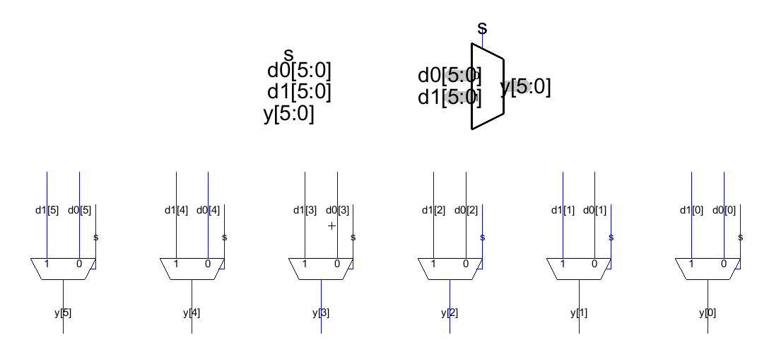
Miscellaneous - 6-bit mux
Figure 14: Schematic and layout of 6-bit mux

Slide 30

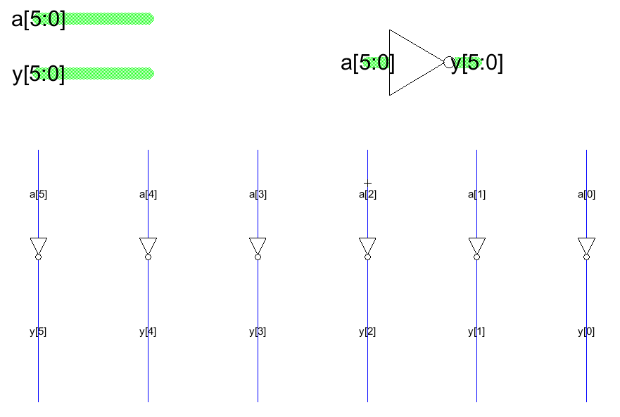
Miscellaneous - 6-bit inverter
Figure 15: Schematic and layout of 6-bit inverter

Slide 31
Overall Design – Components
Table 1: Number of individual modules
Module | Required Number
6-bit Adder | 18
6-bit Comparator | 11
6-bit Multiplexer | 10
1-bit Multiplexer | 12
1-bit Inverter | 6

Slide 32
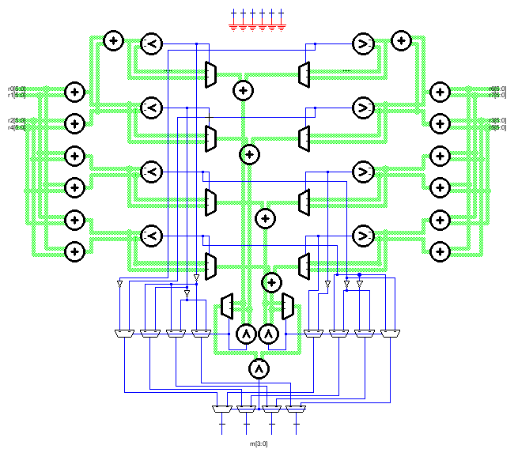
Overall Design - Schematic
r0[5:0]
r6[5:0]
r1[5:0]
r7[5:0]
r2[5:0]
r3[5:0]
r4[5:0]
r5[5:0]
m[3:0]
Figure 16: Schematic of Viterbi decoder

Slide 33
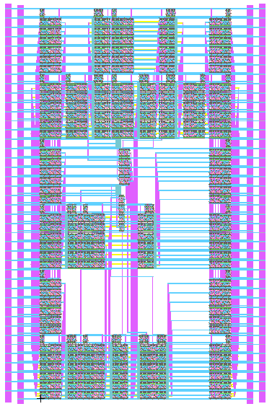
Overall Design – Layout (with CRA)
Figure 17: Layout of Viterbi decoder with carry-ripple adders

Slide 34
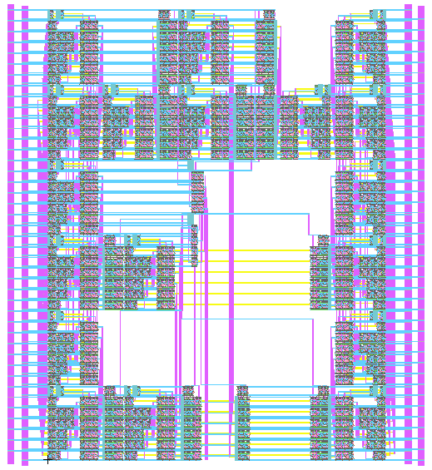
Overall Design – Layout (with KSA)
Figure 18: Layout of Viterbi decoder with kogge-stone adders

Slide 35
Testing
Harsh Aurora, Dylan Watts

Slide 36
Logic Simulators
Harsh Aurora

Slide 37
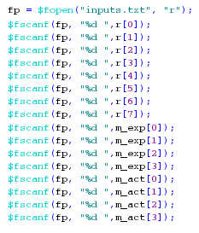
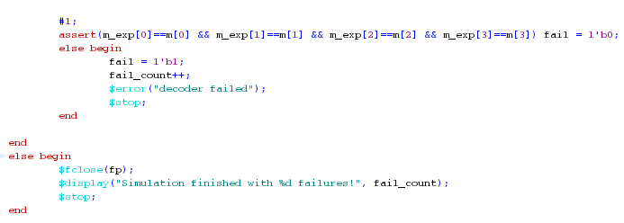

ModelSim
Functional verification of hardware designed in Electric
Create a fixed point Viterbi Decoder in Verilog using ideal hardware components
Extract noisy channel observations in Q4.2 format and the expected output from C code
Build a testbench around the Verilog decoder implementation
Using the extracted data from the C code
Allow for incremental testing of hardware
Substitute ideal Verilog components with Verilog code extracted from Electric
Figure 19: Example of functional testing via ModelSim

Slide 38
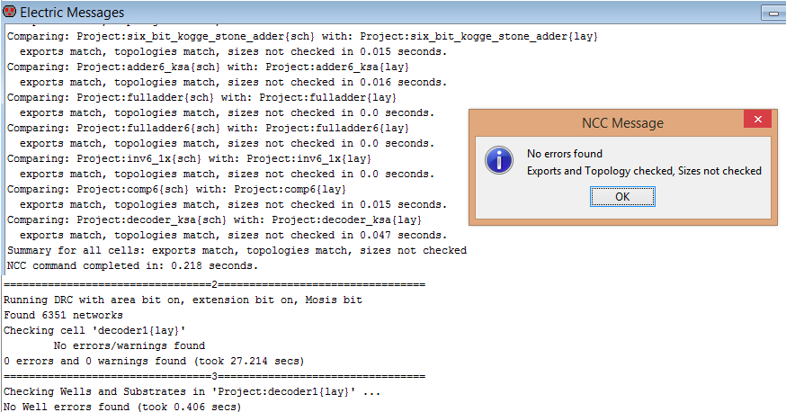
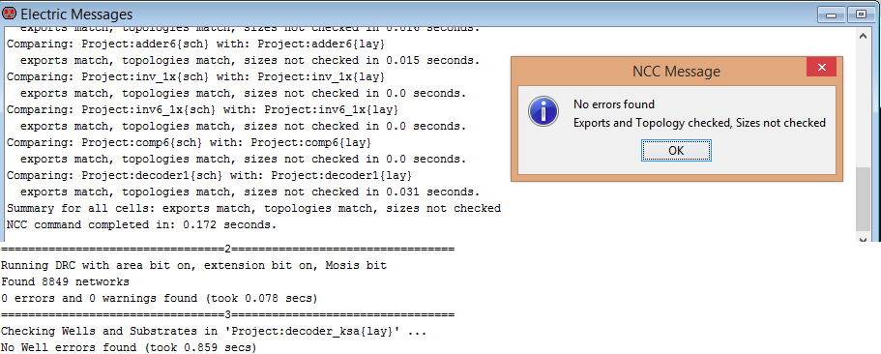
Electric
All schematics and layouts passed DRC, ERC, NCC, as well as functionality testing through ModelSim and IRSIM
Figure 20: Demonstration of passing design checks for both decoder implementations.

Slide 39
Circuit Simulators
Dylan Watts

Slide 40
Challenges and Assumptions
Challenges:
Circuit complexity – overall not a large circuit, but a lot of inputs.
Licensing!!!!
Assumptions:
Assume uniform distribution of input vectors – not true in general, but conservative.
Neglect static power dissipation due to size of process, assume switching power is dominant factor.
For the purposes of power calculation, each module drives a “characteristic capacitive load” which is a weighted average of interconnect and input capacitance.
Delay of all outputs equal to the largest propagation delay for multi-output modules.
False paths are neglected.
Interconnect is neglected
The transistor are uniformly sized using the “1x” ratio (between 1.5-2.5).

Slide 41
Power Analysis
8 inputs of 6 bits each – Possible combinations are 2⁴⁸ = 281 trillion!
Impractical to test all possible combinations of inputs and outputs in SPICE.
Can use a bounding approach.
Test all possible combinations of input vectors for individual modules and observe the power statistics
Min/avg/max power consumption.
Multiply individual statistics by the number of modules in the circuit.
By assuming every component in circuit is operating at the worst case input, can obtain a very conservative estimate of worst-case power consumption for the overall circuit.

Slide 42
Power Analysis
Ripple-Carry and Kogge-Stone adder/comparator each take two six-bit input vectors:
2¹² = 4096 possible input combinations.
2-input MUX takes two six-bit input vectors, 1 select line:
Since it’s one or the other, can simplify to 1 six-bit input vector and one select line.
2⁷ = 128 possible input combinations.
Can generate these inputs intelligently by adding voltage pulses oscillating at specific frequencies:

Slide 43
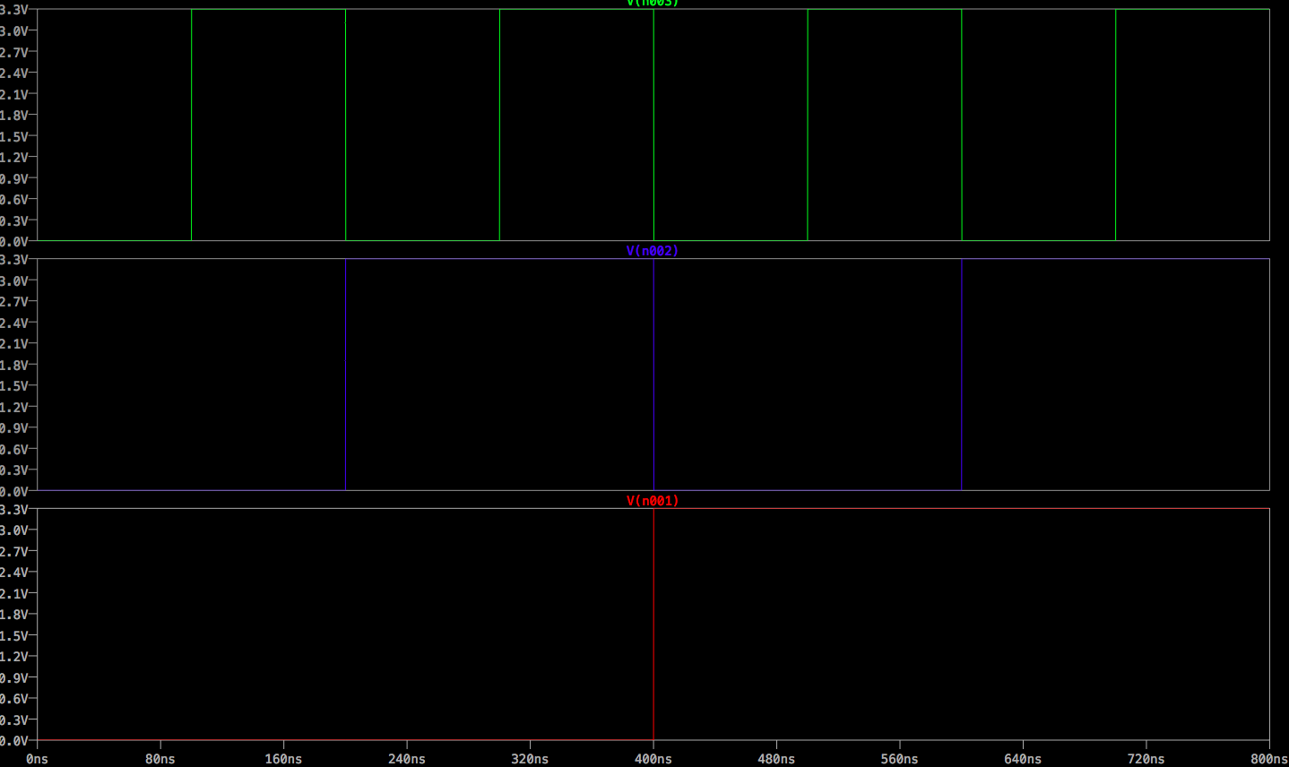
Power Analysis
Figure 21: Addition of periodic voltages to obtain desired waveform

Slide 44
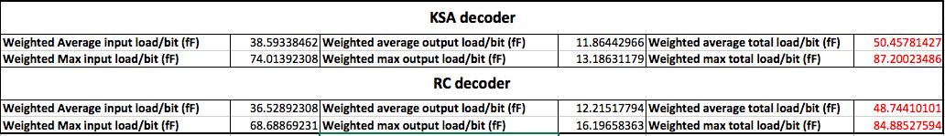
Power Analysis
Since each circuit is being evaluated independently, need to provide a “characteristic load”.
If interconnect is neglected, load is a combination of output capacitance and input capacitance of the connected module.
Obtain a weighted average of input capacitance for all submodules
Table 2: Average and Maximum load capacitances/bit on each module.

Slide 45
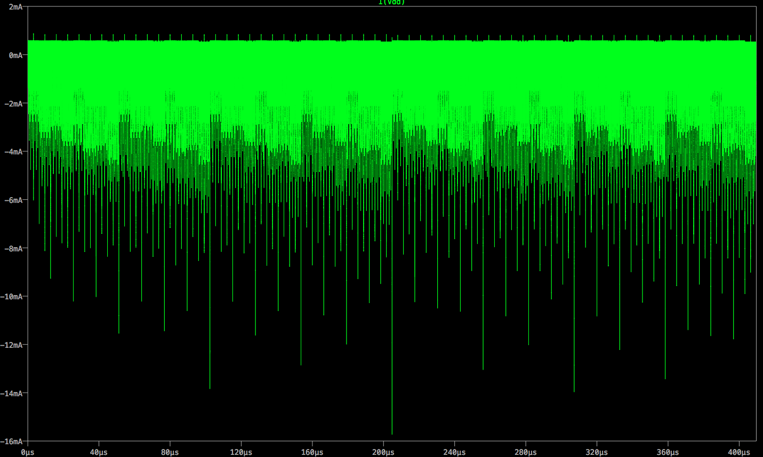
Power Simulation – adder6_KSA_avg
Figure 22: Spice simulation for all 4096 possible combinations

Slide 46
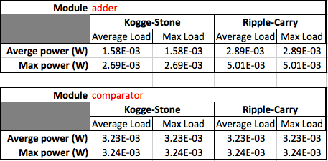


Module Results – Average/Max Load
Table 3: Power usage of various sub-modules
Notes:
Using netlists generated by electric and LTSPICE, an open source alternative to PSPICE and HSPICE we can analyze the power consumption of the four different modules.

Slide 47

Circuit Results – Average/Max Load
Table 4: Power usage of the two decoder implementations under various loading conditions

Slide 48

Propagation Delay: Static Timing Analysis
Can convert into a network of nodes and directed edges. The node weight corresponds to the delay of the component and the edge weight corresponds to the delay of the interconnect
Figure 23 Reproduced from [2]: conversion of logic paths into edge-weighted graph for calculation of shortest and longest path
Tools which can perform static timing analysis Cadence/Synopsis
Unfortunately had to make due with what was available – had to get creative.

Slide 49
Static Timing Analysis
Gate Delay
Delay of individual gates using built in RC timing simulator. Obtained using Electric and IRSIM.
Wire and gate delay combined into a node/edge weighted directed graph. Shortest/longest path algorithms run on Matlab.
Delay of wires connecting individual gates using a 4 segment $π$-model. Obtained using Electric ‘Layout’ and LTSPICE.
Wire and component delay combined into a node/edge weighted directed graph. Shortest/longest path algorithms run on Matlab.
Component Delay
Interconnect Delay
Circuit Delay

Slide 50
Static Timing Analysis
Gate Delay
Delay of individual gates using built in RC timing simulator. Obtained using Electric and IRSIM.
Wire and gate delay combined into a node/edge weighted directed graph. Shortest/longest path algorithms run on Matlab.
Delay of wires connecting individual gates using a 4 segment $π$-model. Obtained using Electric ‘Layout’ and LTSPICE.
Wire and component delay combined into a node/edge weighted directed graph. Shortest/longest path algorithms run on Matlab.
Component Delay
Interconnect Delay
Circuit Delay

Slide 51

Individual Gate Delays
Typically provided by manufacturer
Can use IRSIM, a simulation program which uses rectangular waveforms, but takes into account an RC delay model
Figure 24: Propagation delay for a typical gate measured in IRSIM.

Slide 52

Figure 25: Gate delays for all main foundational gates.

Slide 53

Component Delay
With the gate delay and neglecting wire delay can determine longest/shortest path through various submodules, gradually moving up the hierarchy
Example: adder_ksa
Longest Path:
Largest delay: adder6_ksa
2 x Largest delay: MUX6
Shortest Path:
Shortest path: inverter
Shortest path: and3
Shortest path:MUX6
Figure 25: Visual detection of longest ands shortest path

Slide 54


Component Delay
Table 6: Delays for various sub-modules under various loading conditions.

Slide 55

Circuit Delay
Once all submodules have been calculated for each circuit implementation, can determine the overall delay of the circuit:
Longest Path:
3 x Largest delay: adder_ksa
3 x Largest delay: comparator
2 x Largest Delay: MUX6
Largest delay: MUX2
Shortest Path:
3 x shortest delay: adder_ksa
Shortest delay: comparator
Shortest delay: inverter
2 x Shortest delay: MUX2
Figure 26: Visual detection of longest and shortest path.

Slide 56

Circuit Delay
Table 7: Delay of decoder implementations under various loading conditions.

Slide 57

Verify with Typical Cases - ISIM
Can verify the validity of the bounds by running a full simulation of certain test vectors on IRSIM. As a byproduct, we can determine whether the circuit functions correctly!
Figure 27: Visualization of propagation delay and correct functionality of the circuit using IRSIM.

Slide 58

Circuit Delay

Slide 59
Results Summary
Design Implementation:
Both designs pass all relevant design checks (DRC, ERC,NCC)
Functionality:
Both implementations function accordingly in both ModelSim and IRSIM.
Power Usage:
The Kogge-Stone adder uses less power. (Topic of further investigation)
Propagation Delay:
In 3 out of 4 cases Kogge-Stone is faster.
Table 8: Comparison of two decoder implementations.

Slide 60
Summary of Major Work

Slide 61
Summary of Major Work
Design of a custom architecture and data structure for the optimized encoding and decoding of (8,4,4) codewords.
Implementation of design of two different implementations, one optimized for speed and the other power, on both Schematic and Layout.
Full functional verification on ModelSim and partial verification on IRSIM.
Fulfillment of all design checks (DRC, ERC, NCC).
Exhaustive testing of decoder implementations under various loading regimens.
Determination of an upper and lower bound for power consumption and propagation delay.
Partial validation of upper and lower bound via IRSIM simulation.

Slide 62
Future Work

Slide 63

Future Work
Interconnect Delay
Important to include – can account for up to 80% of overall delay of a circuit in modern processes [1].
4 segment $π$-model is sufficient to characterize the wire.
Comparator
Replace the fulladder in the comparator with a Kogge-Stone adder. Should increase speed and reduce critical path.
Transistor Sizing
Size the transistors to provide ideal ratio for propagation delay.

Slide 64
References

Slide 65
[1] CoN.West ad D.M. Harris, CMOS VLSI Design A Circuits and Systems Perspective, 4th ed., Addison-Wesley, 2011.
[2] VLSI Concepts, and online center for all who have interest in the Semiconductor industry; http://www.vlsi-expert.com/2011/03/static-timing-analysis-sta-basic-timing.html, Wed.March 9 2011.

